Slide 1
Market Basket Analysis

Slide 2
Market Basket Analysis
Introduction to Market Basket Analysis
Terminology
Association Rule

Slide 3
Market Basket Analysis

Slide 4
Introduction to Market Basket Analysis
Market Basket Analysis is a mathematical modeling technique based upon the theory that if you buy a certain group of items, you are likely to buy another group of items.
Market basket analysis seeks to find relationships between purchases.
MBA uses "Association Rule Mining” – used to find an association between different objects in a set, find frequent patterns in a transaction database, relational databases or any other information repository.
This is used in marketing, retailing, web mining, medical diagnosis
It can tell you what items do customers frequently buy together by generating a set of rules called Association Rules: "if this, then that ”
Market basket analysis is Amazon.com's use of "customers who bought book A also bought book B”

Slide 5

Basic Terminologies
Transaction or Itemset: A set of items
Support: It is the measure of how often the collection of items in the association occurs together as a percentage of all transactions
Confidence: It is the measure of uncertainty or trust worthiness associated with each discovered pattern
Frequent Itemset: An itemset satisfying minimum support
Strong Association Rules: Rules that satisfy both minimum support threshold and a minimum confidence threshold.
Lift Value: The lift value of an association rule is the ratio of the confidence of the rule and the expected confidence of the rule.
Rule form: Antecedent → Consequent [support, confidence]

Slide 6
How association rules can be used
Let the rule discovered be
{Pepsi,...} {Potato Chips}
Potato chips as consequent => Can be used to determine what should be done to boost its sales
Pepsi in the antecedent => Can be used to see which products would be affected if the store discontinues selling Pepsi
Pepsi in antecedent and Potato chips in the consequent => Can be used to see what products should be sold with Pepsi to promote sale of Potato Chips

Slide 7
How association rules can be used
Changing the store layout
Customer behavior analysis
Catalogue Design
Cross Marketing in online stores
What are the trending items customers buy
Customized emails with add-on sales.

Slide 8
Association Rule: Example
In a store , there are 1000 transactions overall. Item A appears in 80 transactions and item B in 100 transactions. Items A and B appear in 20 transactions together.
Support is the number of times the itemset appears in the total transactions
Support (A and B) = 20 / 1000 = 2%
Confidence is the conditional probability a randomly selected transaction will contain A given item B
Confidence = 20/80 = 25%

Slide 9
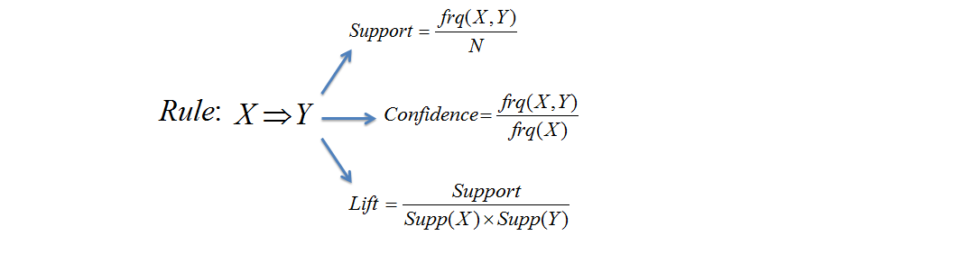
Association Rule: Example
Customers | Items
1 | Shoes, Socks, Tie
2 | Shoes, Socks, Tie, Belt, Shirt
3 | Shoes, Tie
4 | Shoes , Socks, Belt
Discovering for example, that a customer who buys shoes is likely to buy socks
Socks → Tie
Support = 2/4 = 50%
Confidence = 2/3 = 66.67%
Lift = (2/4) / (3/4)*(3/4) = 0.889

Slide 10
Thank You

